Slide 1


Anidu Yakubu Khlaid
April 6, 2025

Slide 2

Outline
Executive Summary
Introduction
Methodology
Results
Conclusion
Appendix

Slide 3

Executive Summary
Summary of methodologies
In this project, I took on the role of a data scientist at a fictional rocket company called Space Y, which aimed to compete with SpaceX, led by billionaire Allon Musk. My objective was to understand the cost dynamics of rocket launches by predicting whether the Falcon 9 first stage would be successfully recovered.

Slide 4
Executive Summary
Summary of all results
I developed a machine learning model to predict whether SpaceX's Falcon 9 first stage would land successfully based on mission data. The model showed strong accuracy, revealing that factors like payload mass, orbit type, and launch site significantly influenced recovery outcomes. I visualized these insights in interactive dashboards, enabling Space Y to estimate launch costs and make informed decisions about reusability and mission planning.

Slide 5
Introduction
Project background and context
The commercial space industry has seen rapid growth, with companies like Virgin Galactic, Rocket Lab, Blue Origin, and SpaceX leading the charge. SpaceX, in particular, revolutionized space travel by significantly reducing launch costs through the reuse of its Falcon 9 rocket’s first stage. By predicting whether the first stage will land successfully, we can estimate the overall launch cost. This project aimed to build a machine learning model to predict first-stage landings, helping Space Y, a new competitor, optimize launch expenses and strategize effectively.

Slide 6
Introduction
Problems you want to find answers
In this project, I aimed to address the following key problems:
1. Predicting First-Stage Recovery: Can we accurately predict whether SpaceX's Falcon 9 first stage will land successfully based on mission parameters?
2. Estimating Launch Costs: How can we use the prediction of first-stage landings to estimate the true cost of a launch?
3. Optimizing Reusability: What factors most influence the likelihood of successful recovery, and how can this information help optimize future rocket missions?
4. Building Dashboards for Decision-Making: How can interactive dashboards be created to help Space Y make data-driven decisions regarding launch strategies and cost management?

Slide 7

Section 1

Slide 8
Methodology
Executive Summary
Data collection methodology:
Data was collected using the SpaceX API and
Web Scraping, then cleaned and normalized for analysis.
Perform data wrangling
The data was cleaned and categorical variables converted into numerical formats.
LaunchSite, Orbit, and Outcome were analyzed; Outcome converted to binary classes (0/1).
Extracted and structured features like Flight Number, Booster Version, and Payload Mass.
Retained geographical data (Longitude, Latitude) for spatial analysis and model training.
Perform exploratory data analysis (EDA) using visualization and SQL
Perform interactive visual analytics using Folium and Plotly Dash
Perform predictive analysis using classification models
How to build, tune, evaluate classification models

Slide 9

Data Collection
Description of Data Collection.
Presentation of data collection process using key phrases and flowcharts

Slide 10
Data Collection – SpaceX API
I collected SpaceX launch data using REST API calls. I accessed the https://api.spacexdata.com/v4/launches/past endpoint using the requests library. The API returned JSON data, which I parsed with .json() and normalized using json_normalize. I made additional API calls to endpoints like /rockets, /payloads, and /cores to get related data. I filtered out Falcon 1 launches and handled nulls (e.g., replacing missing payload mass with the mean).
https://github.com/AY-Khalid/IBM-DATA-SCIENCE/blob/main/jupyter-labs-spacex-data-collection-api.ipynb
Start
Send GET request to SpaceX API (launches/past)
Receive JSON response (list of launches)
Parse JSON → Normalize with json_normalize
Loop through related IDs Call other endpoints (/rockets, /payloads)
Combine data into single DataFrame
Filter for Falcon 9 only
Handle NULL values (e.g., payload mass)
Final Cleaned Dataset

Slide 11
Data Collection - Scraping
Start
Send GET request to Wikipedia page (using requests library)
Receive HTML response
Parse HTML with BeautifulSoup
Locate and extract relevant <table> elements
Extract row and cell data (<tr>, <td>)
Store extracted data in a Pandas DataFrame
Clean data (handle nulls, convert data types)
Merge with API data if needed
Final dataset ready for analysis
I used requests and BeautifulSoup to scrape Falcon 9 launch tables from Wikipedia, parsed the HTML to extract table data, and converted it into a Pandas DataFrame. I cleaned the data, handled missing values, and formatted it to align with API data for further analysis.
Github link: https://github.com/AY-Khalid/IBM-DATA-SCIENCE/blob/main/jupyter-labs-webscraping.ipynb

Slide 12
Data Wrangling
Start
Select relevant columns (e.g., Payload, Launch Site, Orbit, Outcome)
Filter for Falcon 9 launches only
Convert categorical variables (e.g., Orbit, Launch Site) using one-hot encoding
Convert Outcome to binary (0 = failure, 1 = success)
Handle missing values (e.g., replace NULLs in Payload Mass with mean)
Merge API and scraped data if needed
Final cleaned dataset ready for modeling
Data Processing
The data was processed by cleaning and converting categorical variables into numerical formats. Columns such as LaunchSite, Orbit, and Outcome were analyzed, with Outcome being converted into binary classes (0 for failure, 1 for success). Additional features like Flight Number, Booster Version, and Payload Mass were extracted and structured, and geographical data like Longitude and Latitude were retained for spatial analysis. This cleaned data was then ready for model training.
Github URL:
https://github.com/AY-Khalid/IBM-DATA-SCIENCE/blob/main/labs-jupyter-spacex-Data%20wrangling.ipynb

Slide 13
EDA with Data Visualization
Summary of Charts used.
I plotted several charts to explore and visualize the data effectively. A histogram was used to show the distribution of payload mass, helping identify typical payload ranges. Bar charts compared launch success rates across different launch sites and booster versions. A scatter plot was used to examine the relationship between payload mass and landing outcome. These charts helped uncover patterns, correlations, and insights useful for model training and business decisions.
GitHub URL: https://github.com/AY-Khalid/IBM-DATA-SCIENCE/blob/main/edadataviz.ipynb

Slide 14
EDA with SQL
Summary of SQL performed:
Selected all launch records from the dataset using SELECT * FROM SPACEXDATASET.
Filtered launches by year using WHERE clause (e.g., WHERE date LIKE '2018%').
Retrieved successful landings only by filtering with WHERE landing_success = 1.
Grouped launches by site using GROUP BY LaunchSite to count launches per site.
Calculated average payload mass with AVG(PayloadMass) to understand typical mission weight.
Joined tables (if applicable) to merge data such as rocket details with launch outcomes.
Ordered results by descending frequency or payload mass using ORDER BY clause.
Used LIMIT to preview top results for quick inspection during analysis.
GitHub URL: https://github.com/AY-Khalid/IBM-DATA-SCIENCE/blob/main/jupyter-labs-eda-sql-coursera_sqllite.ipynb

Slide 15
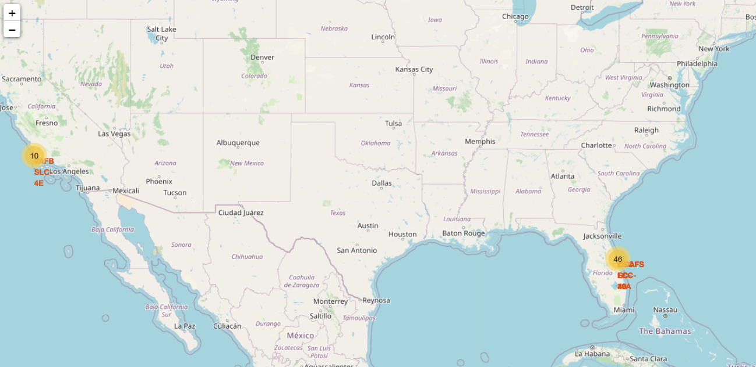
Build an Interactive Map with Folium
Summary of Map Objects and why they were added
Markers were added to show the exact locations of Falcon 9 launch sites, helping visualize spatial distribution.
Circles were used to highlight areas around launch sites, indicating their geographical spread and significance.
Popup labels were attached to markers to display launch site names for better context and interactivity.
GitHub URL: https://github.com/AY-Khalid/IBM-DATA-SCIENCE/blob/main/lab_jupyter_launch_site_location.ipynb

Slide 16
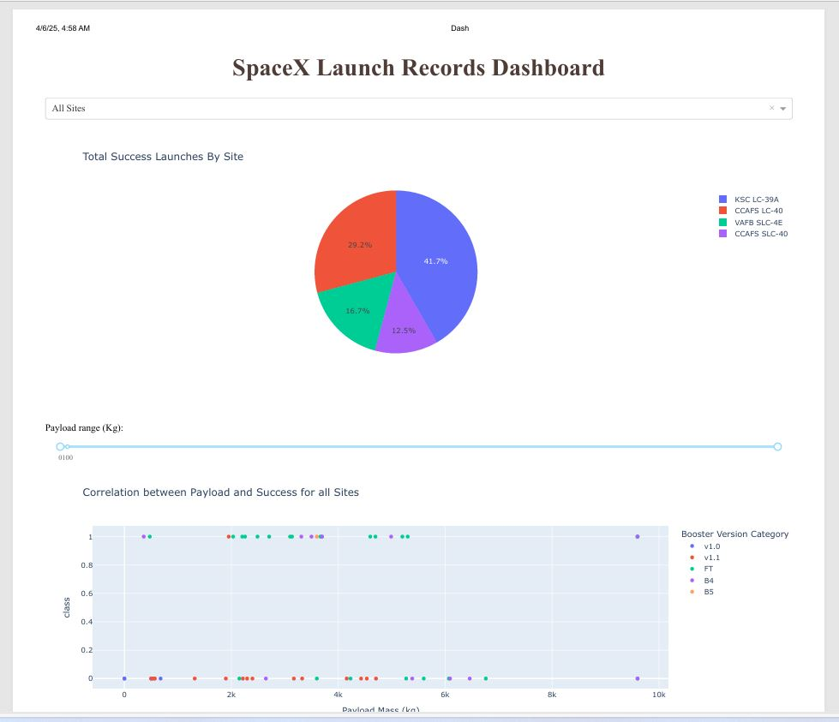
Build a Dashboard with Plotly Dash
Summary of plots/graphs and interactive visuals used.
Bar Charts showing success counts by launch site helped compare site performance.
Pie Charts visualized overall success vs. failure rates for easy interpretation of outcomes.
Scatter Plots displayed payload mass vs. success outcome, revealing correlations between mass and landing success.
Dropdown Menus allowed filtering by launch site, enabling targeted analysis.
Sliders for payload mass range helped interactively explore success trends by mass.
GitHub URL: https://github.com/AY-Khalid/IBM-DATA-SCIENCE/blob/main/spacex-dash-app.py

Slide 17
Predictive Analysis (Classification)
Summary of Model Development Process
Built multiple classification models including Logistic Regression, SVM, KNN, and Decision Tree.
Split the dataset into training and testing sets to evaluate model performance.
Trained models using key features and the binary outcome (landing success).
Evaluated performance using accuracy, precision, recall, and F1-score.
Used cross-validation to ensure model stability and generalization.
Performed hyperparameter tuning with GridSearchCV to find the best model settings.
Selected the best model based on highest cross-validation score and overall metrics.
FlowChart:
Start
Select features and label (binary outcome)
Train models (Logistic Regression, SVM, KNN, Decision Tree)
Evaluate using accuracy, precision, recall, F1-score
Apply k-fold cross-validation
Tune hyperparameters with GridSearchCV
Compare models based on performance metrics
Select best-performing model
Use model to predict future launch outcomes
GitHub URL:
https://github.com/AY-Khalid/IBM-DATA-SCIENCE/blob/main/SpaceX_Machine%20Learning%20Prediction_Part_5.ipynb

Slide 18
Results
Exploratory data analysis results
The EDA revealed key patterns like outcome imbalance and launch site distribution.Preprocessing steps, including handling missing values and encoding, prepared the data for modeling.Insights from EDA helped address feature correlations, scale numerical features, and manage class imbalance, laying the foundation for better predictive models.
Predictive analysis results
While all four models—Decision Tree, SVM, Logistic Regression, and KNN—achieved similar performance in terms of accuracy, the decision to choose the best model would depend on factors like interpretability, computation time, and complexity. Since they all perform similarly in this case, one could opt for a simpler model like Logistic Regression for faster training times or a Decision Tree for its interpretability.
Interactive analytics demo in screenshots

Slide 19

Section 2

Slide 20
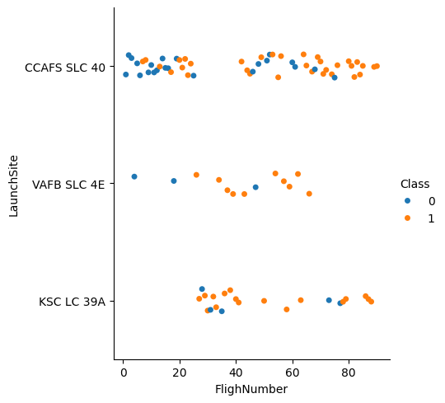
Flight Number vs. Launch Site
The scatter plot shows the flight number and the site where the rocket was launched.

Slide 21
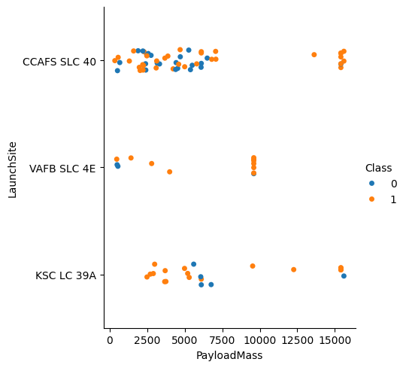
Payload vs. Launch Site
The scatter plot show the load and the site of the rocket.

Slide 22
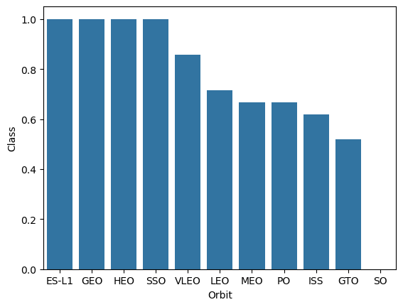
Success Rate vs. Orbit Type
Bar chart for the success rate of each orbit type

Slide 23
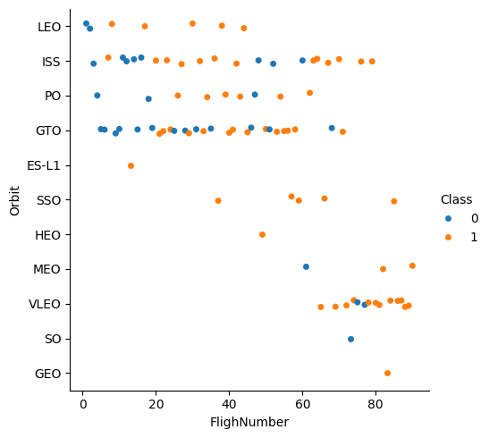
Flight Number vs. Orbit Type
Scatter point of Flight number vs. Orbit type

Slide 24
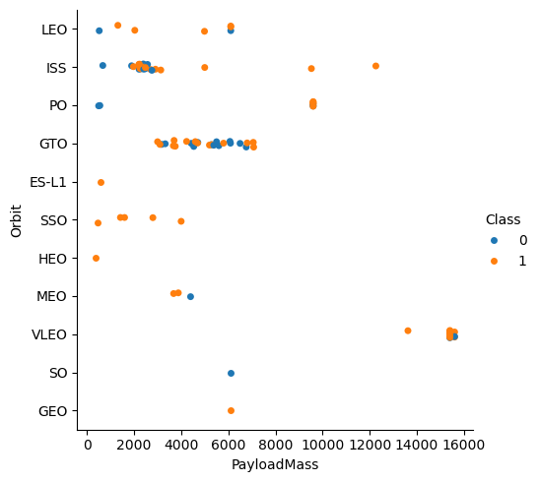
Payload vs. Orbit Type
Scatter point of payload vs. orbit type

Slide 25
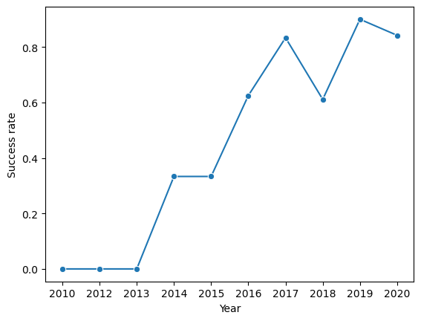
Launch Success Yearly Trend
Line chart of yearly average success rate

Slide 26
All Launch Site Names
Launch_Site
CCAFS LC-40
VAFB SLC-4E
KSC LC-39A
CCAFS SLC-40
Unique launch sites

Slide 27
Launch Site Names Begin with 'CCA'
Date | Time (UTC) | Booster_Version | Launch_Site | Payload | PAYLOAD_MASS__KG_ | Orbit | Customer | Mission_Outcome | Landing_Outcome
2010-06-04 | 18:45:00 | F9 v1.0 B0003 | CCAFS LC-40 | Dragon Spacecraft Qualification Unit | 0 | LEO | SpaceX | Success | Failure (parachute)
2010-12-08 | 15:43:00 | F9 v1.0 B0004 | CCAFS LC-40 | Dragon demo flight C1, two CubeSats, barrel of Brouere cheese | 0 | LEO (ISS) | NASA (COTS) NRO | Success | Failure (parachute)
2012-05-22 | 7:44:00 | F9 v1.0 B0005 | CCAFS LC-40 | Dragon demo flight C2 | 525 | LEO (ISS) | NASA (COTS) | Success | No attempt
2012-10-08 | 0:35:00 | F9 v1.0 B0006 | CCAFS LC-40 | SpaceX CRS-1 | 500 | LEO (ISS) | NASA (CRS) | Success | No attempt
2013-03-01 | 15:10:00 | F9 v1.0 B0007 | CCAFS LC-40 | SpaceX CRS-2 | 677 | LEO (ISS) | NASA (CRS) | Success | No attempt

Slide 28
Total Payload Mass
Payload carried by boosters from NAS
TOTAL PAYLOAD_MASS__KG_)
45596

Slide 29
Average Payload Mass by F9 v1.1
AVERAGE PAYLOAD_MASS__KG_
2534.6666666666665

Slide 30
First Successful Ground Landing Date
MINIMUM DATE
2015-12-22
Dates of the first successful landing outcome on ground pad

Slide 31
Successful Drone Ship Landing with Payload between 4000 and 6000
Names of boosters which have successfully landed on drone ship and had payload mass greater than 4000 but less than 6000
F9 B5 B1049.3
F9 B5 B1051.2
F9 B5 B1048.4
F9 B5 B1056.3
F9 B5 B1049.4
F9 B5 B1051.3
F9 B5 B1051.4
F9 B5B1058.1
F9 B5 B1049.5
F9 B5 B1059.3
F9 B5B1060.1
F9 B5 B1058.2
F9 B5 B1051.5
F9 B5 B1049.6
F9 B5 B1060.2
F9 B5 B1058.3
F9 B5 B1051.6
F9 B5 B1060.3
F9 B5B1062.1
F9 B5B1061.1
F9 B5 B1049.7
Booster_Version
F9 FT B1022
F9 FT B1026
F9 FT B1029.1
F9 FT B1021.2
F9 FT B1032.1
F9 FT B1036.1
F9 B4 B1040.1
F9 B4 B1041.1
F9 FT B1031.2
F9 B4 B1043.1
F9 B5B1047.1
F9 B5B1048.1
F9 B5 B1046.2
F9 B5B1049.1
F9 B5 B1047.2
F9 B5 B1049.2
F9 B5 B1048.3
F9 B5B1051.1

Slide 32
Total Number of Successful and Failure Mission Outcomes
Total number of successful and failure mission outcomes
Mission_Outcome | count(Mission_Outcome)
Failure (in flight) | 1
Success | 98
Success | 1
Success (payload status unclear) | 1

Slide 33
Boosters Carried Maximum Payload
Names of the booster which have carried the maximum payload mas
Booster_Version | payload
F9 B5 B1060.3 | 15600
F9 B5 B1060.2 | 15600
F9 B5 B1058.3 | 15600
F9 B5 B1056.4 | 15600
F9 B5 B1051.6 | 15600
F9 B5 B1051.4 | 15600
F9 B5 B1051.3 | 15600
F9 B5 B1049.7 | 15600
F9 B5 B1049.5 | 15600
F9 B5 B1049.4 | 15600
F9 B5 B1048.5 | 15600
F9 B5 B1048.4 | 15600
F9 B5 B1049.6 | 15440
F9 B5 B1059.3 | 15410
F9 B5 B1051.5 | 14932
F9 v1.1 | 14642
F9 B5 B1049.3 | 13620
F9 B5B1058.1 | 12530
F9 B5B1061.1 | 12500
Booster that carried payload above 12,000

Slide 34
2015 Launch Records
Failed landing_outcomes in drone ship, their booster versions, and launch site names for in year 2015
Date | month | Landing_Outcome | Booster_Version | Launch_Site
2015-01-10 | 01 | Failure (drone ship) | F9 v1.1 B1012 | CCAFS LC-40
2015-04-14 | 04 | Failure (drone ship) | F9 v1.1 B1015 | CCAFS LC-40

Slide 35
Rank Landing Outcomes Between 2010-06-04 and 2017-03-20
Count of landing outcomes (such as Failure (drone ship) or Success (ground pad)) between the date 2010-06-04 and 2017-03-20, in descending order
Landing_Outcome | rank | count
No attempt | 1 | 10
Success (drone ship) | 2 | 5
Failure (drone ship) | 2 | 5
Success (ground pad) | 4 | 3
Controlled (ocean) | 4 | 3
Uncontrolled (ocean) | 6 | 2
Failure (parachute) | 6 | 2
Precluded (drone ship) | 8 | 1

Slide 36

Section 3

Slide 37

Folium Map 1

Slide 38
Folium Map 2

Slide 39

Folium Map 3

Slide 40

Section 4

Slide 41
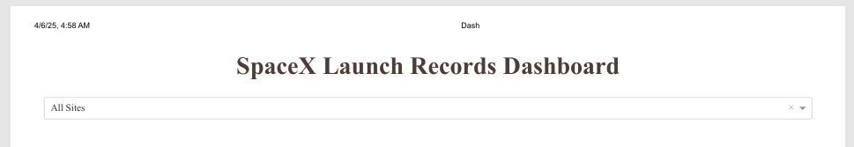
Dashboard Title and Dropdown

Slide 42
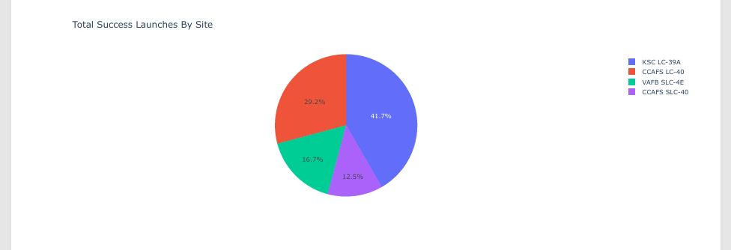
Dashboard Pie Chart

Slide 43
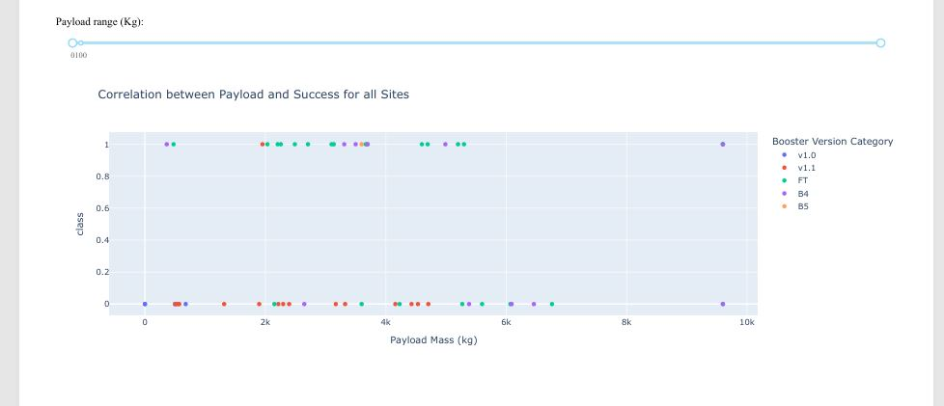
Dashboard Scatterplot

Slide 44

Section 5

Slide 45
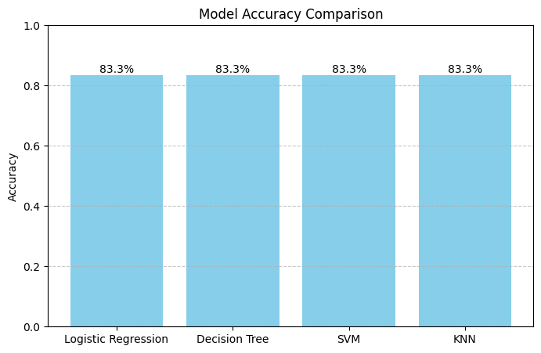
Classification Accuracy

Slide 46

Confusion Matrix

Slide 47

Conclusions
Comprehensive Data Understanding: Exploratory Data Analysis revealed key patterns such as class imbalance and launch site distribution, shaping the direction of modeling.
Effective Data Preparation: Data cleaning, feature engineering, and handling missing values ensured the dataset was model-ready and consistent.
Multiple Models Evaluated: Decision Tree, Logistic Regression, KNN, and SVM were trained and evaluated using 10-fold cross-validation.
Consistent Performance Across Models: All models achieved around 83% accuracy, indicating stable and reliable classification performance.
Foundation for Future Work: The project establishes a solid base for further improvement through hyperparameter tuning, feature selection, or ensemble methods.

Slide 48
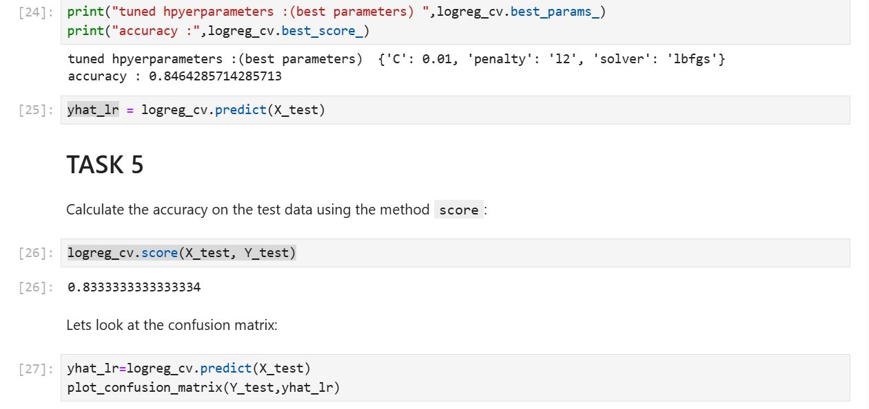
Appendix

Slide 49


